Slide 1


Basic Details of the Team:
Team Name: CIPHER
Team Leader Name: Amith Varma Rudraraju
Team Leader Mobile Number: 98662 75174
Team Leader Email: rvs.amithvarma@gmail.com
No of Team Members: 6
Institute Name: Sagi Rama Krishnam Raju Engineering College

Slide 2
Domain & Problem Statement:
Domain:
Web Development
Problem Statement:
Title: Automated Boarding Call for airline passengers.
Description: To develop a smart last-call notification that ensures passengers board their flights on time by providing automated call alerts.

Slide 3
Motivation :
Increasing Number of Missed Flights
Inefficiency Traditional Alerts(Announcement/SMS may not work)
Need for Smart Automation(Reduces manual effort, enhances efficiency)
Improving Airline and Airport Efficiency

Slide 4
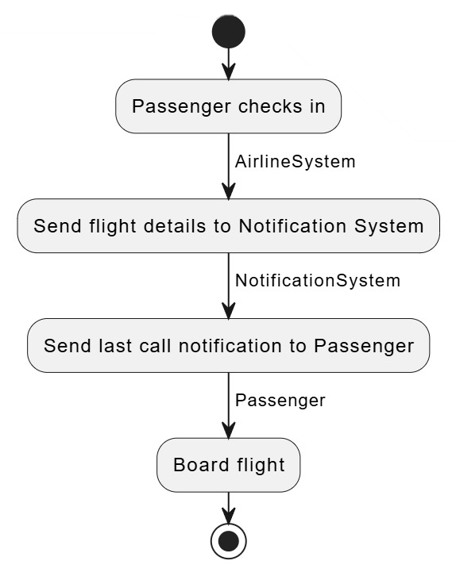
Idea/Approach:
Overview of the System:
Flight Data Integration: Connect to real-time databases for schedules, boarding times, and gate updates.
Passenger Preferences: Gather contact details and preferences for personalized alerts.
Automated Alerts: Trigger notifications (e.g., "last call") via SMS, calls, or emails.
Customizable Options: Allow passengers to customize alerts and adjust timing.

Slide 5
Resources Required:
Frontend (User Interface):
HTML, CSS, JavaScript → For building the web interface.
JavaScript → For interactive elements.
Backend (Server & Business Logic):
PHP → Handling of server-side logic and interaction with databases
Flask → Logic for initiating alerts/calls
Database:
PostgreSQL / MySQL → For structured airline and passenger data.
APIs & External Services:
Cloud Telephony API(Twilio) → For automated calls.

Slide 6
Team Member Details:
Team Leader : Amith Varma Rudraraju
Branch : CSE
Team Member 1 : Deepak Thota
Branch : CSE
Team Member 2 : Sri Sri Gana Kurma
Branch : CSE
Team Member 3 : Ravi Lokesh Thonta
Branch : CSE
Team Member 4 : Chaitanya Manepalli
Branch : AIML
Team Member 5 : Adithya Penjarla
Branch : IT
Year: II
Year: II
Year: II
Year: II
Year: II
Year: II

